Slide 1
New Concepts in Medical Care
Kenneth Brummel-Smith, MD
Charlotte Edwards Maguire Professor of Geriatrics
Florida State University College of Medicine

Slide 2
Course Plan
Lecture/discussion
Open to suggestions for content
Oct 1 – Introduction – Optimal Aging Redux
Oct 8 – Prevention
Oct 15 – Treatment
Oct 22 – Non-medical treatments
Oct 29 – New models of care
Nov 5 – Being an “activated patient”

Slide 3
Contacting Me
Email – ken.brummel-smith@med.fsu.edu
Phone – 644-2291 (expect delays)
Facebook – send me a friend request

Slide 4
Recommended Reading
www.ChoosingWisely.org
“Overdosed America,” by John Abramsom
“Overtreated,” by Shannon Brownlee
“Overdiagnosed,” by Gilbert Welch
“Rethinking Aging: Growing Old and Living Well in an Overtreated America,” by Norton Hadler

Slide 5
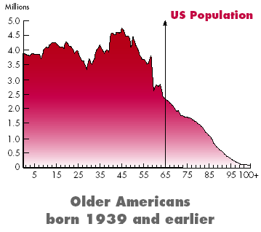
“Silver Tsunami”
(2006)
Notes:
55,000 centenarians now, in 2050 there will be 500,000

Slide 6
A Growing Population
>85 fastest growing segment
2040 – US >65 - 26%
  Japan, Sweden, Italy – 45%
Peak in 2050
  55,000 centenarians now, in 2050 there will be 630,000
Florida is 1st on % of older people (17%)
US has the shortest life expectancy!

Slide 7
Changing Societies & Caregivers
Japan – more adult diapers sold than children’s
Vancouver, BC – outlawed regular door handles on new construction
China – the “4-2-1” problem
2013 – 1st time ever there were more deaths than births in white Americans

Slide 8
Definitions
Life expectancy - how long an “average” person can expect to life, at any age
Life span - the “absolute” longest a human is capable of living

Slide 9
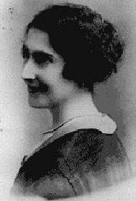
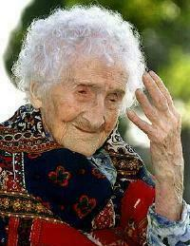
The Oldest Human – Jeanne Calment (1875-1997)
1900
1995

Slide 10
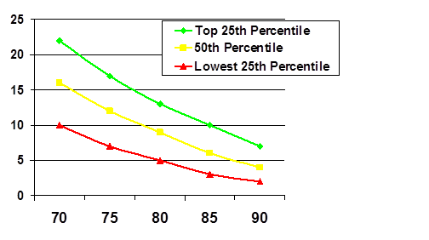
Life Expectancy
Carey EC et al. JAGS 2008; 56:68–75.

Slide 11
Definitions
Optimal aging (Walsh) - The capacity to function across many domains—physical, functional, cognitive, emotional, social, and spiritual – to one’s satisfaction and in spite of one’s medical conditions ^{1, 2}
Successful aging (Rowe) - Absence of disease and disability; high cognitive and physical functioning; and active engagement with life ³

Slide 12
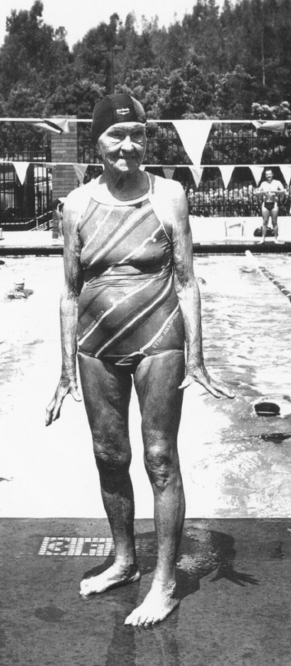
Luella Tyra
Age 92
1984 Nationals
Swam 4 races
Backstroke
Breaststroke
Butterfly
Freestyle

Slide 13
Roots of Optimal Aging
The capacity to adapt across various domains of life
  Physical, functional, cognitive, emotional, social, and spiritual
Adaptation (Arthur Rubenstein)
  Selection
  Optimization
  Compensation
Notes:
Arthur Rubinstein (1887-1982), the noted pianist, played into his 90s. Over the years he adapted by: (1) reducing the number of pieces that he played (selection); (2) putting in more hours of practice (optimization); and (3) decreasing the speed of his playing prior to a fast movement, thereby creating the impression of speed when he entered the faster movement (compensation).¹²

Slide 14
Determinants of Health⁴
Function
Disease
Social environment and support system
Physical environment
Genetic endowment
Individual responses – behavior & perspective
Healthcare system

Slide 15
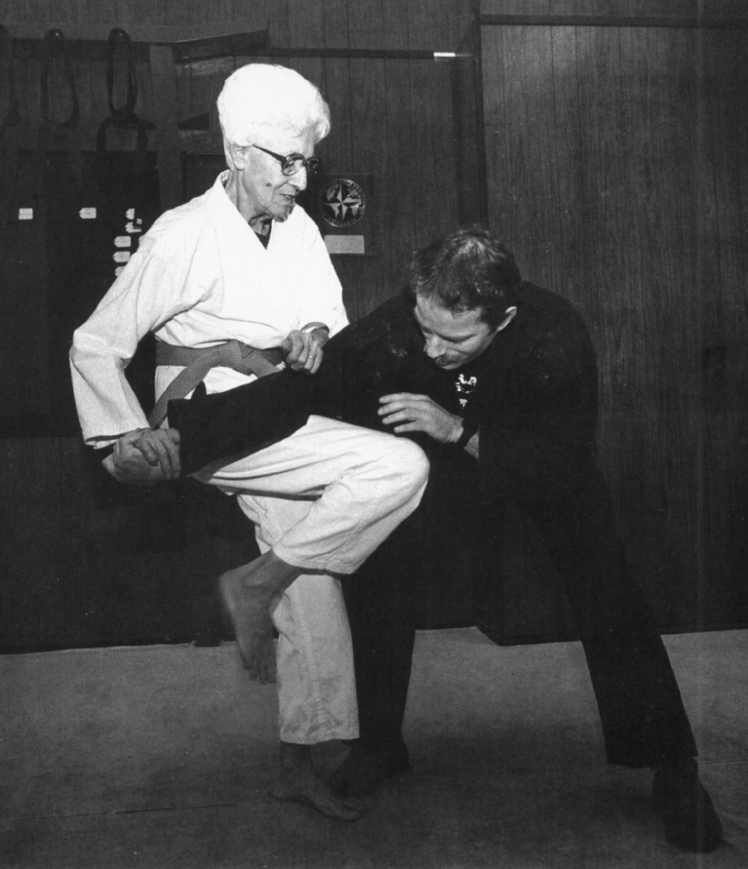
Eleanor Hyndman
Age 80
Started karate at
age 78.
Says it gives her
mental sharpness
Recently won a
gold medal.
Purple belt.

Slide 16
Approaches to Optimal Aging
Biological
  Exercise, nutrition, sleep, avoidance of disease-causing agents, practicing preventive medicine, early treatment of diseases and medical conditions, cognitive stimulation, avoidance of iatrogenic complications
Psychological
  Attitude, viewpoint, stress management, resilience
Notes:
From a societal perspective, increasing exercise is more important than stopping smoking, as many more people are sedentary than smoke.

Slide 17
Sedentary Americans
1 in 4 exercise regularly
22% never exercise
30% of those over age 65 never exercise
Less than 10% participate in vigorous exercise

Slide 18
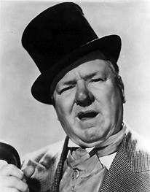
“When I get the
urge to exercise,
I lie down until it passes.”
W.C. Fields

Slide 19
Results of Inactivity
Heart disease
Obesity
Dementia
Depression
Parkinson’s
Stroke
Macular degeneration
High blood pressure
Diabetes
Osteoporosis
Falls
Arthritis
Cancer
There is scientific evidence exercise prevents these.

Slide 20
Benefits of Activity
Decreased heart disease
Reduced weight
Better control of diabetes
Less constipation
Longer independence
Reduced pain in arthritis
Improved activities of daily living
Improved recovery
Better thinking
Modify most diseases
Notes:
Modify most diseases – especially most neurodegenerative diseases

Slide 21
Causes of Mortality
40,842 Men & 12,943 Women, ACLS
Aerobics Center Longitudinal Study, 1970-2004. In progress
Notes:
Lack of fitness (cardiorespiratory fitness or CRF) is a bigger risk factor than all these others.

Slide 22
The Ideal Combination
Strength (muscles)
Endurance (heart and lungs)
Balance (nerves)
Stretching (muscles and joints)
Fiatarone Singh, Exercise to prevent frailty, Clinics Geri Med 2000

Slide 23
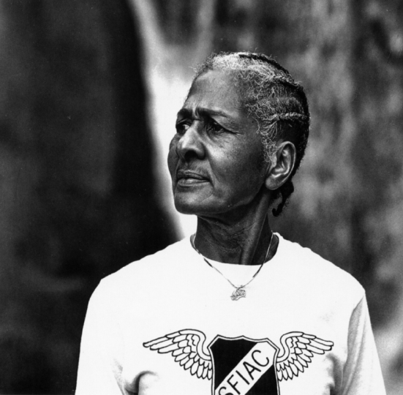
Ada Thomas
Age 72
Started jogging
at age 65
First marathon
at age 68.
“When I look
in the mirror
I like what I see.”

Slide 24
Optimal Cognition (Thinking)
Enhance physical and mental activities
  Variety
  New challenges - “Good” stress
Control risk factors
  Smoking, blood pressure, diabetes, depression
Build strong social relationships
Maintain financial health
Less TV

Slide 25
Out With The Old Ideas
Old ideas
  Brain cells are limited
  Cannot grow new cells after 2 years old
  Repair occurs through recruitment and “rewiring”
New knowledge
  New cells are created and migrate to area of use
  New synapses can develop
  Controlled by BDNF
Brain-derived neurotrophic factor

Slide 26
Ronald Peterson MD
Director of the Alzheimer’s Disease Research Center at Mayo
“Regular physical exercise is probably the best means we have to prevent Alzheimer’s disease today: better than medications, better than intellectual activity, better than supplements and diet.”
  1/3 reduction in risk
American’s spend $6 billion on AD drugs annually

Slide 27
Other Cognition Strategies
Vitamin E – possibly, only if in diet
Omega-3 – possibly, but maybe not
Eating fish - probably
Mild to moderate alcohol intake – possibly
Everything under the sun?

Slide 28
Approaches to Optimal Aging
Social
  Support, activities, work, volunteerism, sexuality, religion, spirituality, “other-orientation,” and “beneficence orientation”
Societal
  Health education, chronic disease self management training, access to information, community services, environmental design, health policies and insurance

Slide 29
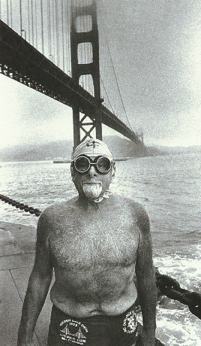
Joe Bruno
71 y/o
Has swum the
Golden Gate
Bridge 53 times.

Slide 30
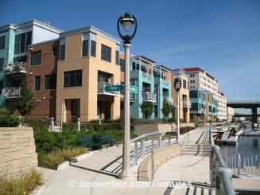
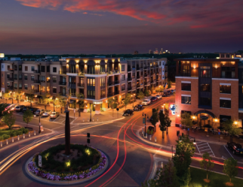
Environmental Design
Promote community connections
  Sidewalks/trails
  Building design
  Rest areas
Street construction
  Left turns
  Lighting
  Sidewalks
  Building style and set-back

Slide 31
Negative Societal Approaches
“Addiction” to medication approaches
  Lipids
  Hypertension
  Diabetes
  Depression
  Sleep
Serious problems versus mild problems

Slide 32
“Anti-Aging Medicine”
American Academy of Anti-aging Medicine
  “We the leaders of the Anti-Aging movement will help to usher in a new modern age for humanity: The Ageless Society. There is a remedy for this apocalypse of aging, and this remedy comes just in time to save America.” R. Klatz, DO
Hormones, antioxidants, diet, exercise
Anti-aging medicine and regenerative biomedical technology - $97 billion industry

Slide 33
Anti-Aging “Treatments”
Human growth hormone (HGH)
  2007 Annals of Internal Medicine review – 31 studies – no benefit, many harms – do not use
DHEA
  Not effective – probably not dangerous at low doses, cancer effects
Antioxidants
  Questionable effectiveness – probably not harmful
Caveat emptor – if an expert advocates for it, and they make $ from selling it, avoid it

Slide 34
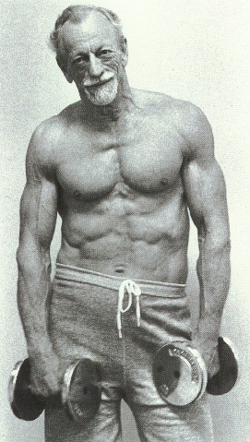
John Turner, MD
67 y/o
“I think physicians have a
responsibility to sell health
at least as much as they
sell pills.”
Growing Old is Not for Sissies
Etta Clark
Pomegrante Books
Petaluma, CA 1990

